Slide 1
MS-EXCEL Capstone Project by
Oluwasanmi Adeola Adesina

Slide 2
Business Overview
FlexTrade is a well-known company in the online shopping world. They have been making shopping easier and better for a long time. They sell all kinds of things, from electronics to clothes.
Their app is designed to be easy to use, hoping to make shopping fun and simple for everyone.
FlexTrade wants to keep improving their app to make sure they stay ahead in the competitive online shopping market
This project will look into how they can make their app even better for users.

Slide 3
AIM OF THE PROJECT
Find UX Problems: Look at how users behave and what they say to find out what needs to be better.
Make Checkout Better: Make it easier and quicker for users to buy things.
Suggest Personalized Products: Use what we know about what users like to suggest other things they might buy.
Get Users to Buy More: Figure out ways to encourage users to spend more money.

Slide 4
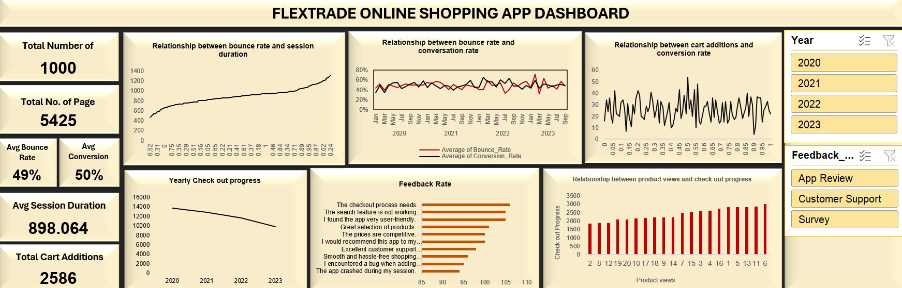
Dashboard Generated to proffer solutions

Slide 5
Case 1
Identify Duplicate Entries;
Finding;
No duplicate entries were found from all the worksheets

Slide 6
Case 2:
Analyze Session Duration: How long do users typically spend on the app? Are shorter sessions associated with higher bounce rates?

Slide 7
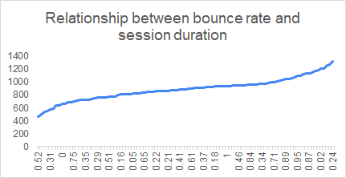
According to the analysis made, there is an average session duration of 15 minutes by all users
The graph provides insights where session duration is on the Y axis and bounce rate on the is on X axis that there is a slight correlation between session duration and bounce rate indicating that shorter sessions are some what associated with higher bounce rate

Slide 8
Case 3:
Investigate Bounce and Conversion Rates:
Is there any significant relationship between both metrics?

Slide 9
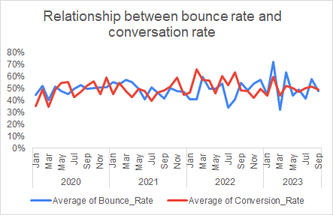
Both the bounce rate and conversion rate fluctuate over time, with no drastic differences between them during most of the period
The two metrics are inversely related as higher bounce rate correspond with lower conversion rate

Slide 10
Case 4:
Understand Cart Behavior: For sessions with cart additions,
how often do users proceed to checkout?

Slide 11
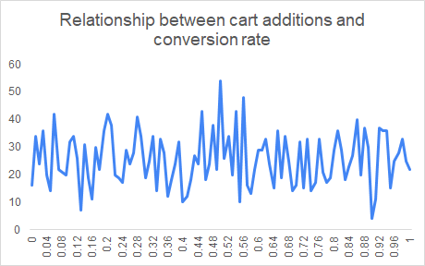
Based on the graph there is no straightforward relationship between the number of cart additions and the likelihood of conversion.
The data suggests that users are proceeding to checkout less frequently over time, even when they add items to their cart. Further investigation is required

Slide 12
Case 5:
Feedback Analysis:
What common themes can you find in the feedback content?

Slide 13
The most critical areas needing attention are the checkout process and search functionality, they are the most frequently mentioned issues by users.
Positive user feedback on the app’s user-friendliness, product selection, and pricing should be maintained and customer support can be improved upon
Addressing bugs and preventing app crashes will also contribute to a more stable and satisfying user experience.

